Slide 1
Satellite Hub Model
Gotta Cache ‘em All
Wesley Chavez / Jonathan Fernow / James Schiffer
Notes:
Wesley

Slide 2
Assignment Constraints Satellite Hub
3 Mobile Device Connections at 11 Mbps (5.5 Mbps up, 5.5 Mbps down)
1 Satellite link to a remote data center at 2.4 Kbps (1.2 Kbps up, 1.2 Kbps down)
Limited Memory, 3 Levels
M1, Max 512 Bytes, $50 / 256 Bytes, Latency 1 tClk
M2, Max 2k Bytes, $10 / 512 Bytes, Latency 8 tClk
M3, Max 10k Bytes, $3 / 1024 Bytes, Latency 15 tClk
Notes:
Wesley

Slide 3
Generic Assumptions
There is no burst mode available in the transmission.
All the data eventually needs to be saved either in our memory or satellite in our simulation.
Cumulative latency is from the beginning of when the transmission is requested to when it is received in the target device, not from the beginning of the first bit of data to the end of the last bit of data.
Decimal Definition of KB and MB: 1000Bytes in Kbytes, 1000*1000Bytes in a Mbyte
The Tag information identifying the unique packet is contained in the original message as this is important information for the upper level applications.
Notes:
Jonathan

Slide 4
Assumption: Memory Latency is Irrelevant
Worst case in simulation?
Lets say we have 8 device links with 16 bits taking about 300 clock cycles to become ready.
Worst case is each device link must access the same memory module on 1 bus.
Memory Latency is 15 clock cycles.
15 * 8 = 120 clock cycles, which would effect the performance of our model.
Memory latency only matters for last read/write
Cumulative latency overshadows total memory latency by 5 orders of magnitude
Notes:
Wesley

Slide 5
Assumption about Device Communication
Devices are smart.
They will send a command to the Satellite Hub even if there is an ongoing transmission.
We can use the data in that command to keep track of events we were unable to handle.
For example:
Device sends a send command to us, but we cannot handle it.
Another device requests that data.
We can NOT grab that from the satellite.

Slide 6
Assumption about Memory Management Unit
The memory management unit consists of buffers
Makeup of the Memory Management
2 bits for size of data
2 bytes for the replacement policy data.
4 bits for start address
4 bits for end address
4 bytes total.
Maximum MMU memory required
4 bytes * 32 tags = 128 bytes.

Slide 7
System Overview
Notes:
Jonathan

Slide 8
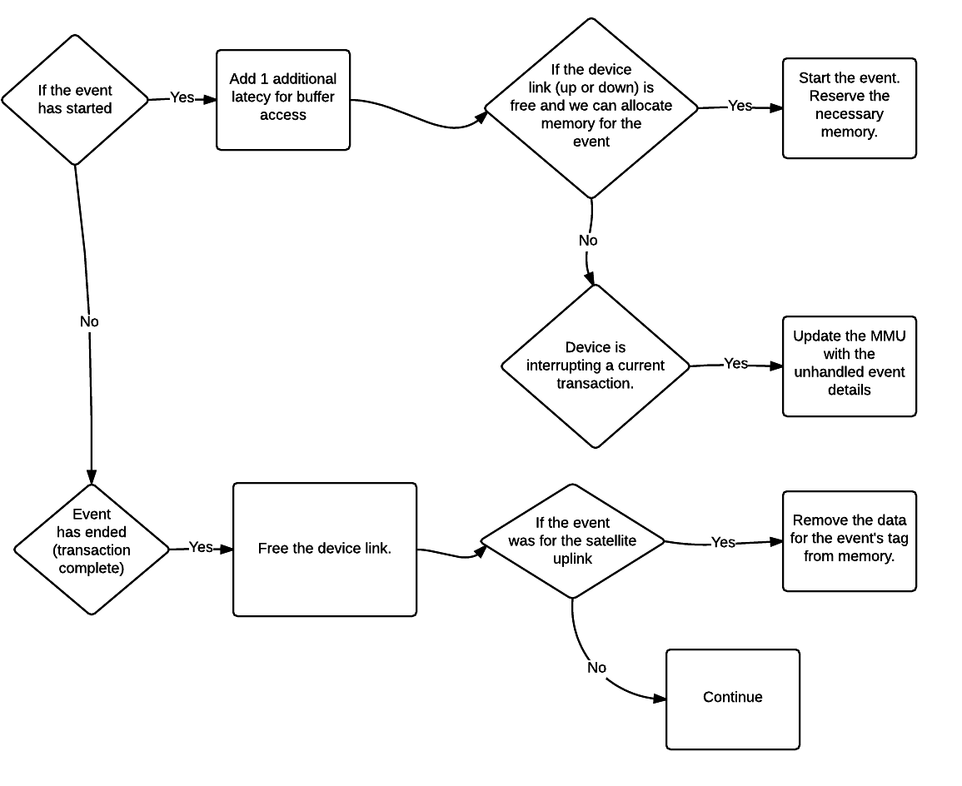
For Each Event During a Clock Cycle

Slide 9
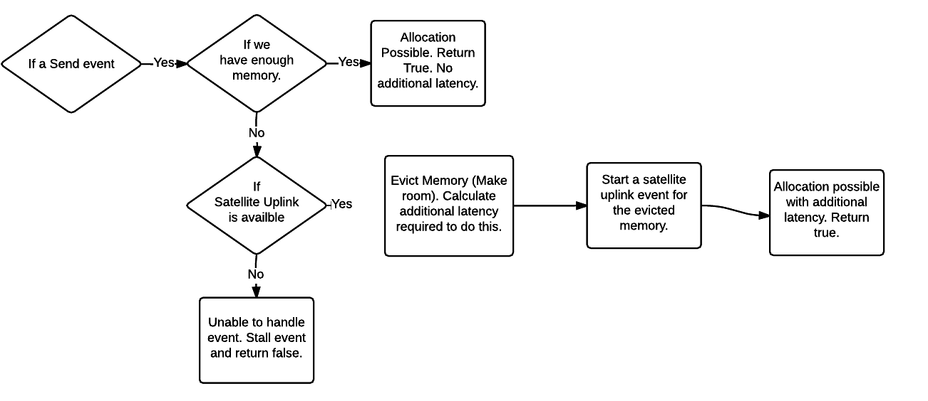
Send Event Memory Allocation

Slide 10
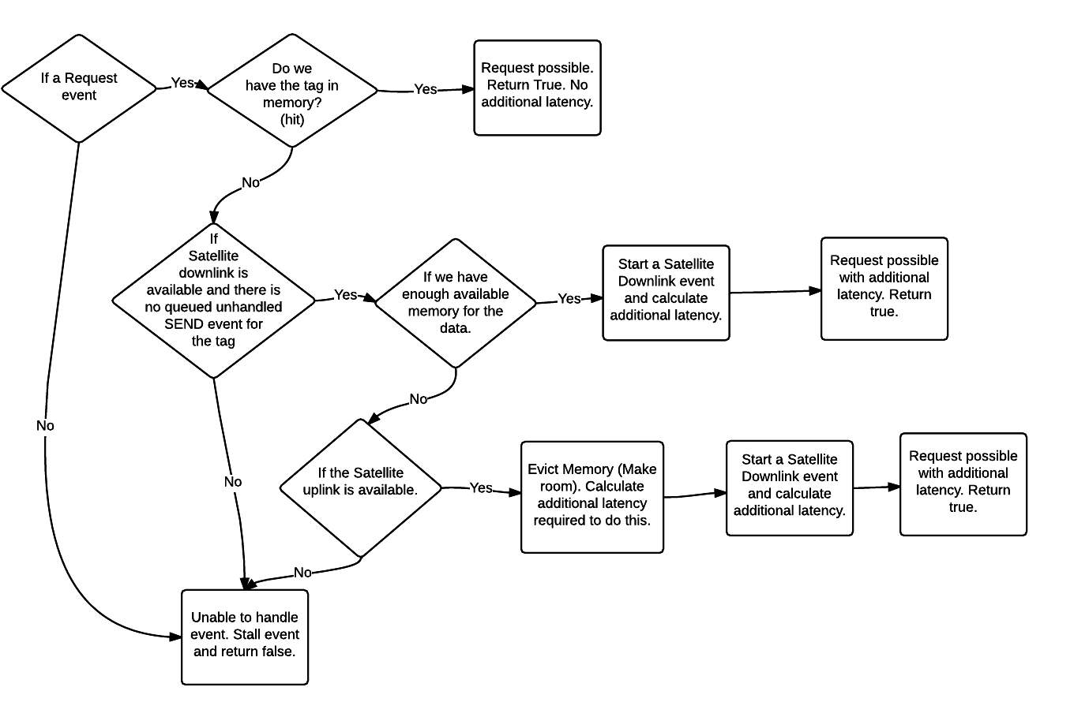
Request Event Memory Allocation

Slide 11
Simulations
Notes:
Jonathan

Slide 12
LRU Result Summary
L2,L3 is ~2x faster than L3
L3 is ~2.33x cheaper than L2,L3 solution
L3 and L2,L3 have approximately the same satellite cost
Conclusion L3 is a better solution as the hardware cost benefit is better than the cumulative latency benefit
Notes:
Jonathan

Slide 13
Tracking Replacement Policy Snoop Request Queue before Eviction
We are tracking unhandled events
So before we evict something, check if it is queued for a request
If it is, choose something else that is not queued for a request
If we must evict something in the unhandled request queue, make it the last request.
Simulations are not done on this yet, but the results will be in the final submission.

Slide 14
Thank you!

Slide 15
Backup

Slide 16
Two Memory Management Memory Tag Options Blocks of data ---vs--- Beginning and End locations

Slide 17
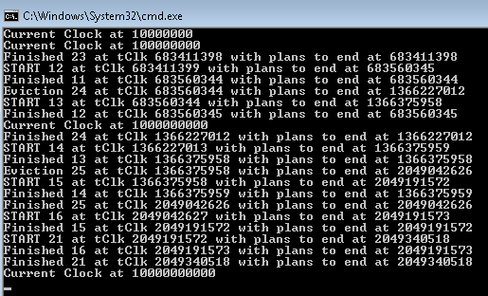
Most Recent Used vs. Least Recent Used
Each thread ran on a dedicated core for a day and didn’t finish for the MRU for the CSV3 file
For Refence the CSV2 completed in 10 seconds on the same platform and LRU finished in <8 hours

